Slide 1

POF
Performance Optimized Fluids

Slide 2

What is POF?
POF: Performance Optimized Fluids
What is NVIDIA Flex?
What is the task of Flex?

Slide 3
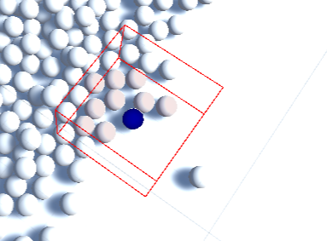
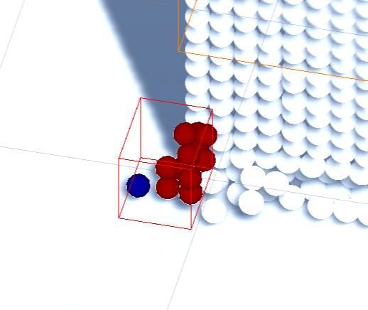
AIM
Integrating particle-based fluid simulation into the Unity platform.
Leaving a ready system for other people using the algorithms we have integrated.
Determining an evaluation platform to test algorithms with test results.
Fig 1: Hash System-1
Fig 2: Hash System-2

Slide 4

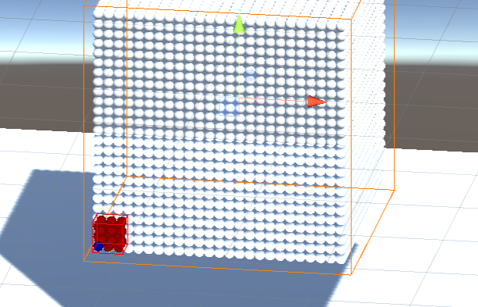
Objectives
Using particle-based fluid simulation through the Unity.
Recognizing surface particles mathematically.
Creating stable test environment for users.
Establishing a system to comparing algorithms.
Fig 3: Perfect Cube

Slide 5
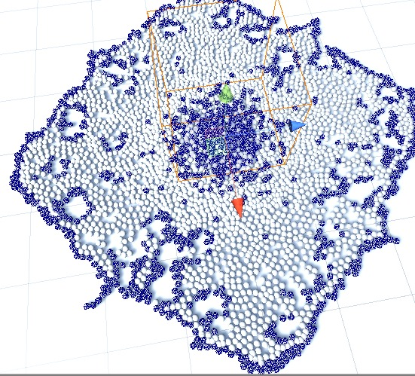
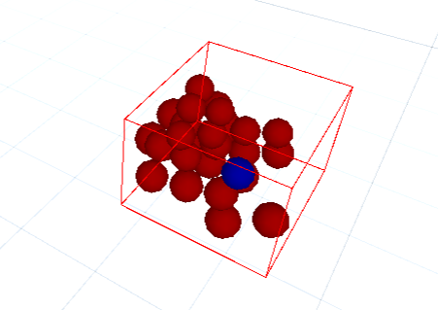
IMPLEMENTATİON
1-) Hash System
2-) Surface Recognition
Fig 5: Finding Surface Particles
Fig 4: Tracking Particle within a Cell

Slide 6

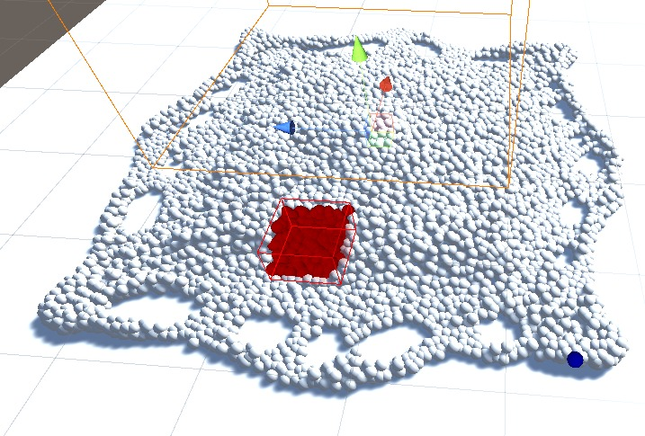
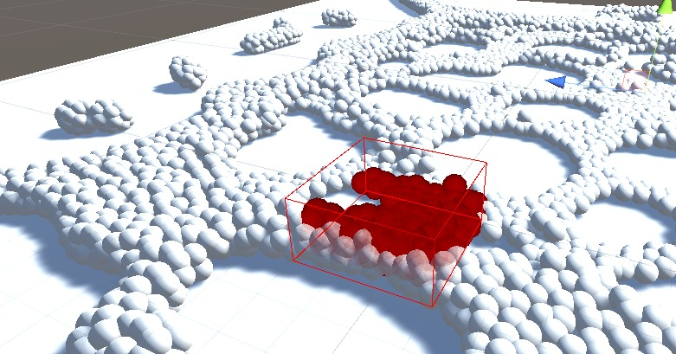
HASH SYSTEM
What is Hash system?
What are the benefits of Hash system?
How we implemented Hash system?
Fig 6: Hash System-3
Fig 7: Hash System-4

Slide 7
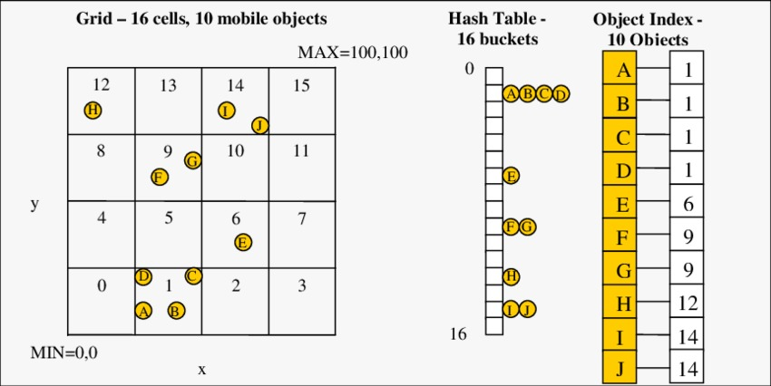
HASH SYSTEM
Fig 8: Hash System in 2D

Slide 8
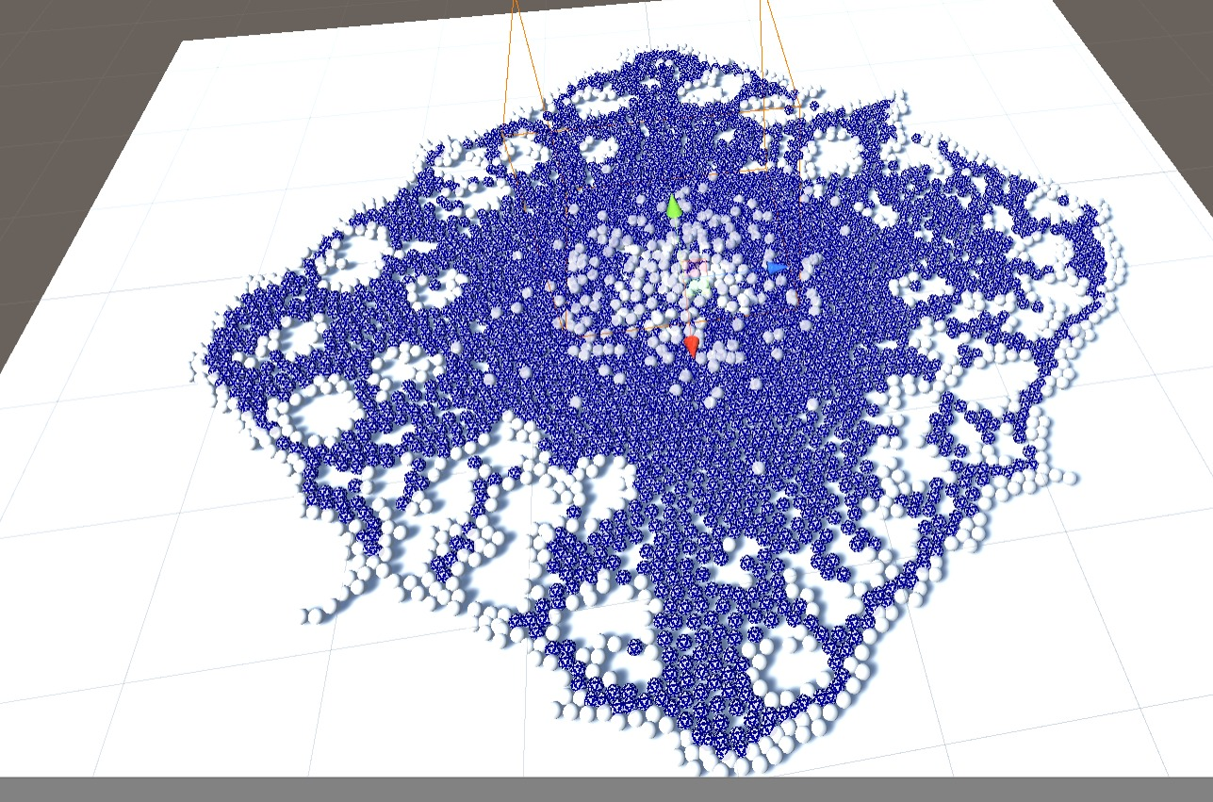
SURFACE RECOGNITION
What is surface?
What are the benefits of the surface recognition algorithm?
How we find surface?
Fig 9: Inner Particles Represented with Blue in Surface Recognition

Slide 9
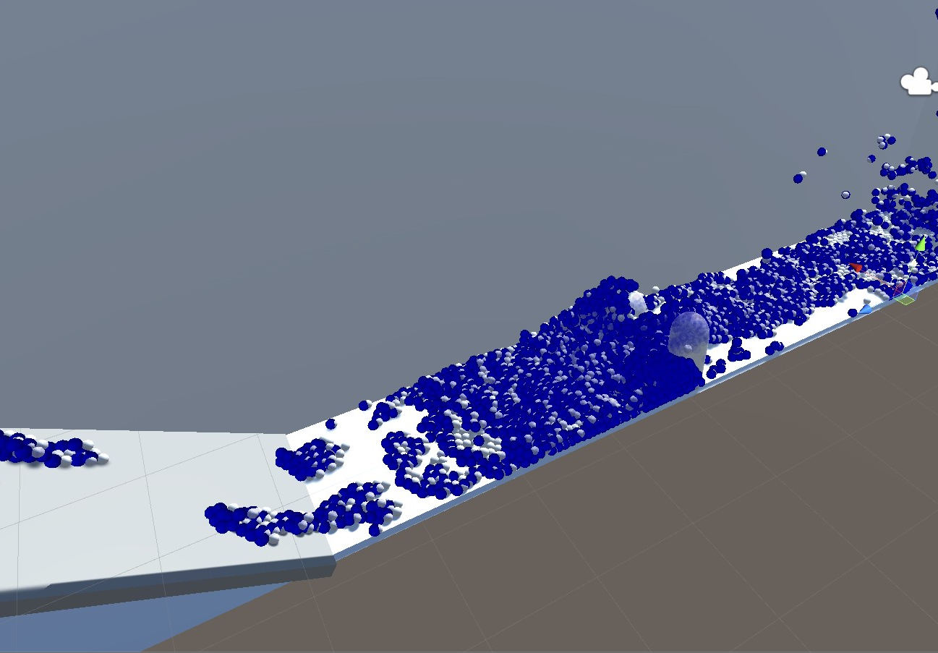
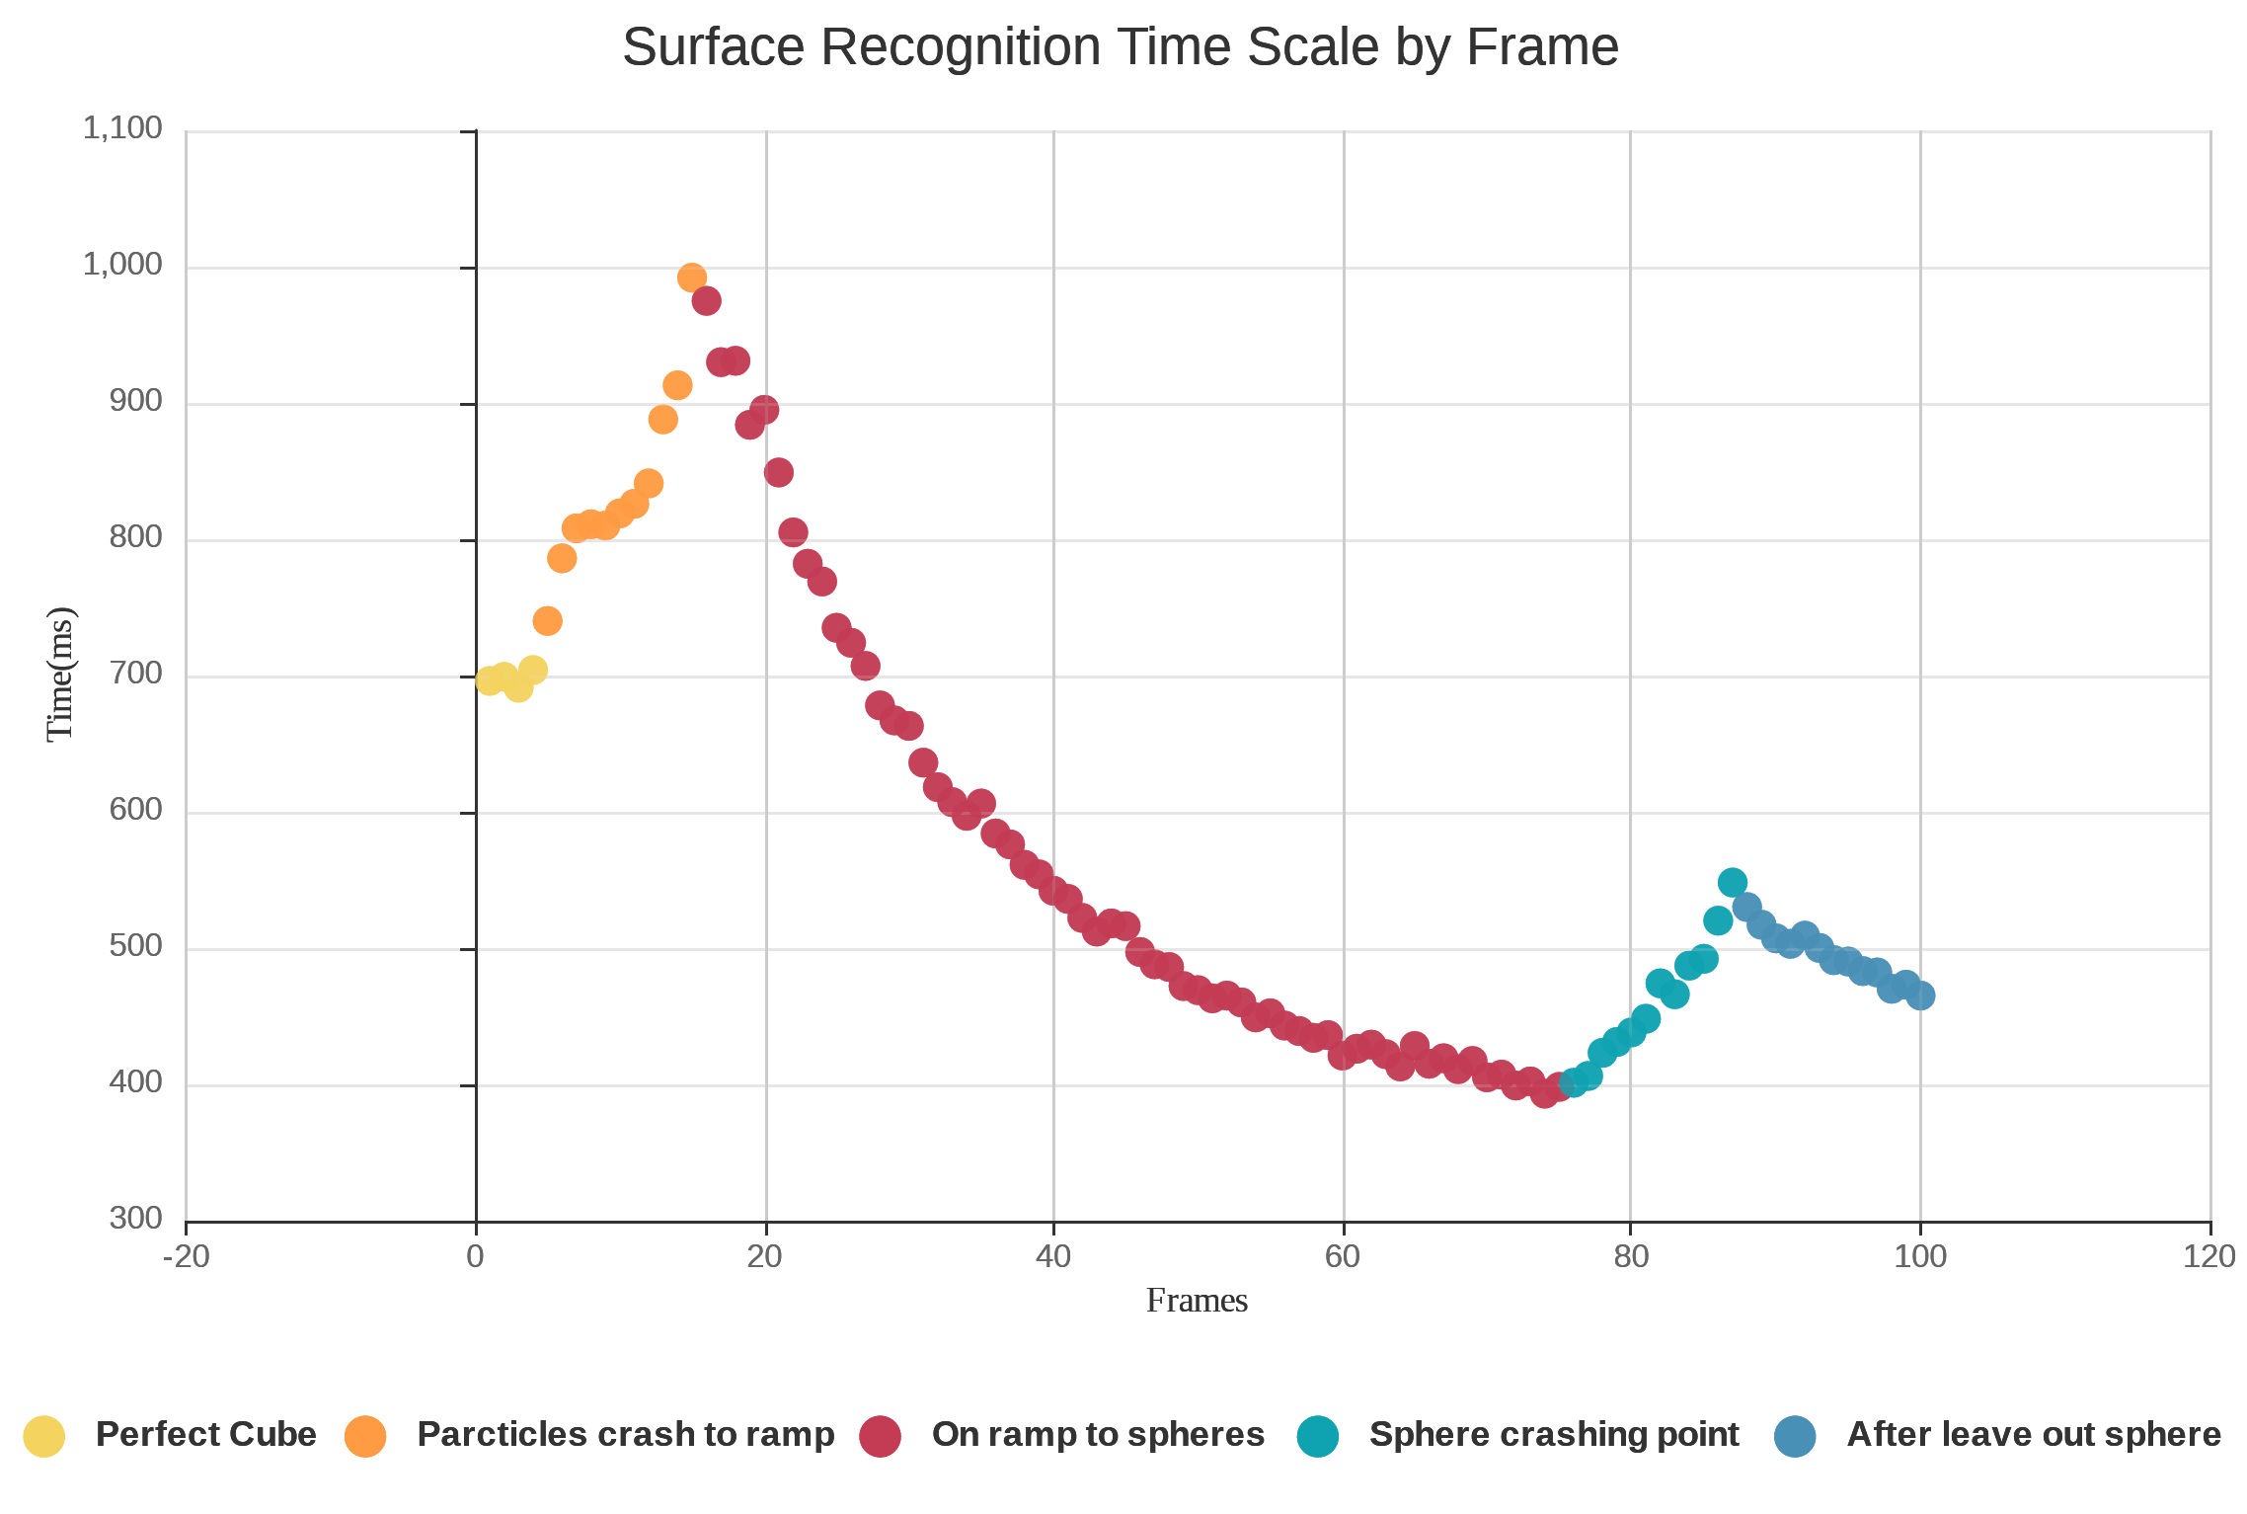
TEST RESULTS 1
Fig 10: Test Scene-1
Fig 11: Surface Recognition Chart as Time-Frame

Slide 10
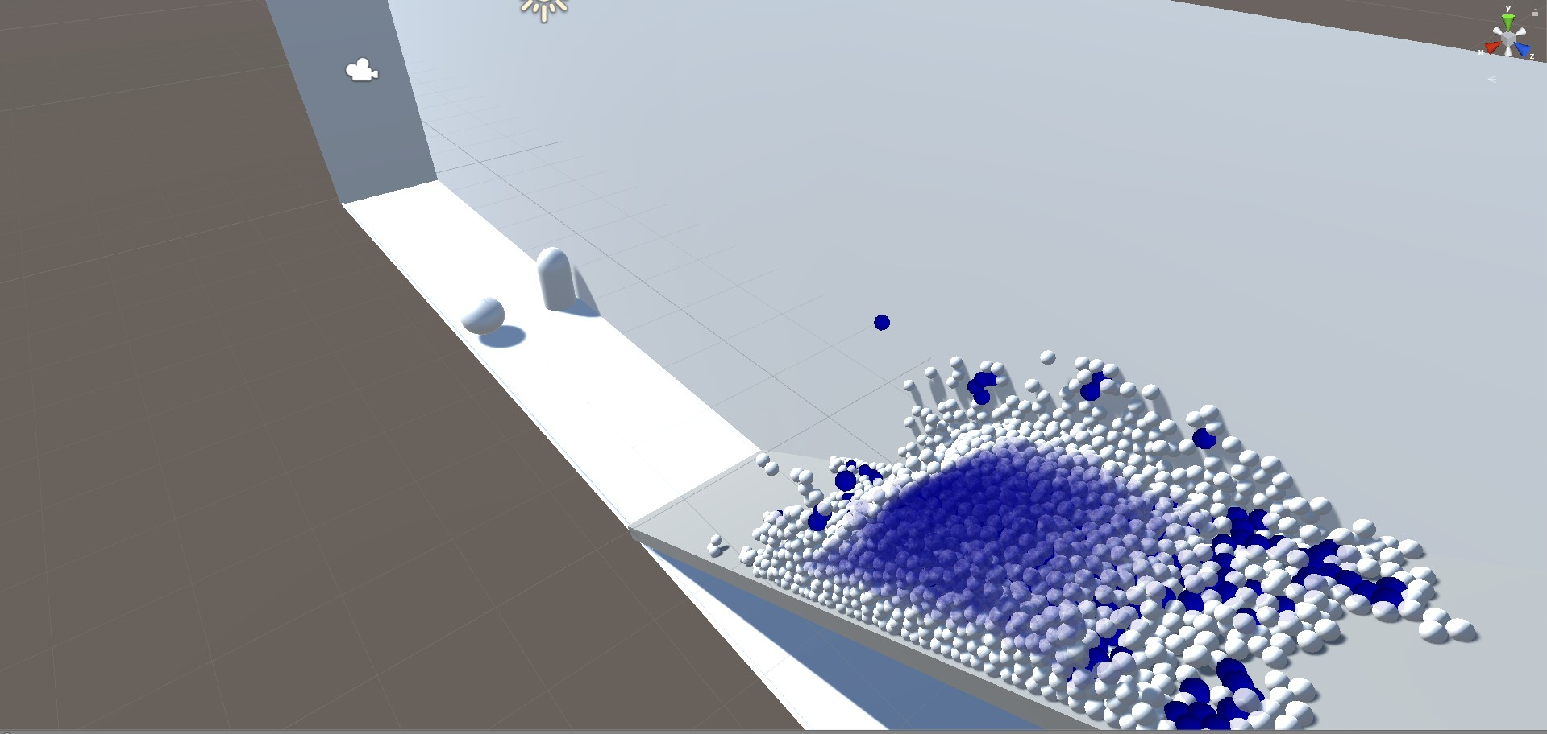
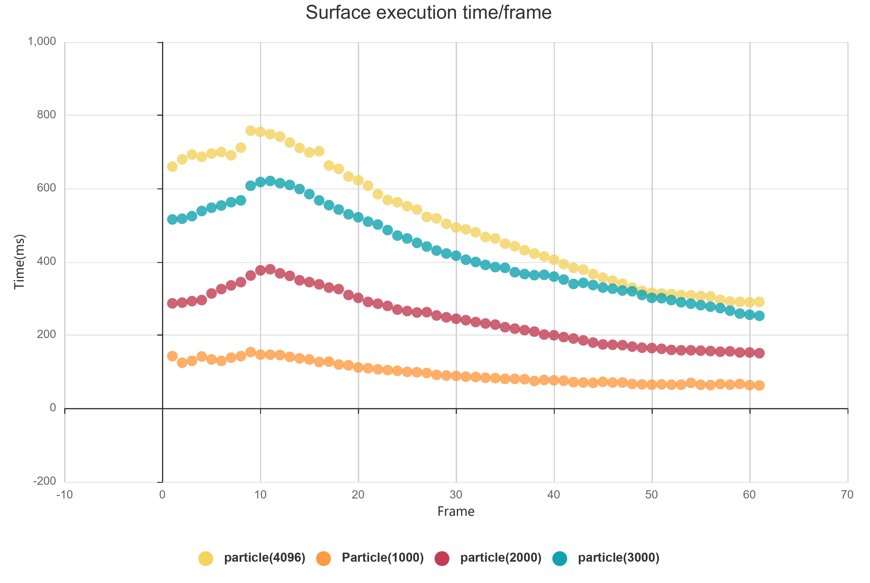
TEST RESULTS 2
Fig 12: Test Scene-2
Fig 13: Surface Execution by Particle Comparison

Slide 11
Conclusion
Prepared a test environment for other algorithms to compare.
Implemented various methods : Hash algorithm, Surface Recognition algorithm.

Slide 12

THANK YOU FOR LISTENING ☺
Baran Budak 15070001012
Cihanser Çalışkan 16070001020
İsmail Mekan 15070001048

